Slide 1
Basic Java training
Harinath Mallepally
harinath@careerscale.in
http://careerscale.in
Notes:
IMPORTANT – PLEASE READ.
Use this template to create your online courses. Change the template as you see fit, including the logo, images and copyright information. Add your speaker's notes to the Notes section of the PowerPoint (e.g. THIS SECTION) and then submit it to Dual Code's PowerFlash service.
Your PowerPoint will be converted to a Flash-based eLearning module or presentation. A professional voice-over artist will read you speaker’s notes and incorporate the resulting audio files in the Flash course. You will also have the option to save the course to a standard (Flash + HTML) format or SCORM compliant package so you can deploy it in your Learning Management System of choice.
Try it for FREE. Visit http://www.dualcode.com/elearning/powerflash.htm for more details.

Slide 2
What we offer
Customized courses on:
Basic Java and advance Java (JEE)
Spring framework
Hibernate, Mybatis
Mule ESB
Build tools (Ant, Maven, Gradle, Jenkins, Teamcity etc)
Agile methologies(Scrum)
QA (Functional, Automation, PEN testing)
Projects and product dev(Design,develop, maintain)

Slide 3
Course Overview
This course is intended for people who:
B.Sc/B.Tech / M.C.A Freshers/Students
IT Professionals (Non Java technologies)

Slide 4
Pre-requisites
Before taking this course, the student must have successfully completed the following pre-requisites:
Computer basics
Working programming knowledge (C, C++ etc)

Slide 5
Course Outcomes
Upon completion of this course, you will be able to:
Concepts of Object Oriented Programming
Java - programming basics
Important java core modules
JEE (Java Enterprise Edition) - important components
Advanced Java frameworks
Spring, Hibernate
Struts 2, Spring MVC
Junit/Test NG

Slide 6
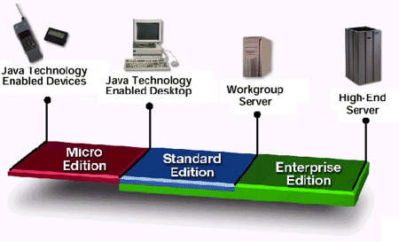
What is Java?
Java is a programming language originally developed by James Gosling at Sun Microsystems. Now Oracle has taken Over Sun
Java is platform independent. Write once and run anywhere (windows, Unix, Linux, Mac etc)
Java is found everywhere

Slide 7
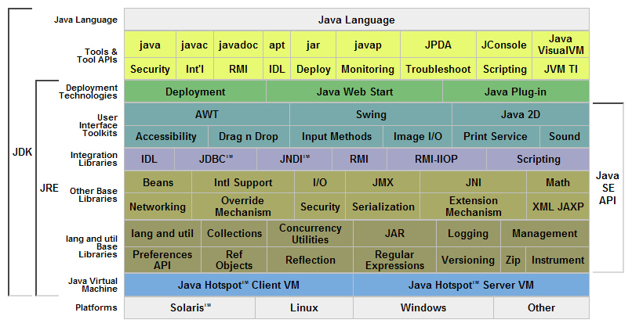
JDK and JRE – The low level details (Do not worry if you don’t get it fully)

Slide 8
Java – release history
JDK 1.0 - 23rd Jan 1996 (code named as Oak)
JDK 1.1 19TH Feb 1997
JDK 1.2 8Th Dec 1998 (Playground)
JDK 1.3 8th May 2000 (Kestrel)
JDK 1.4 6th Feb 2002 (Merlin)
JDK 5.0 30th Sept 2004 (Tiger)
JDK 6 11 De 2006 (Mustang)
JDK 7 07 July 2011 (Dolphin)

Slide 9
Who uses Java?
1.1 billion desktops run java
930 million Java Runtime Environment downloads each year
3 billion mobile phones run Java
31 times more Java phones ship every year than Apple and Android combined
100% of all Blu-ray players run Java
1.4 billion Java Cards are manufactured each year
Java powers set-top boxes, printers, Web cams, games, car navigation systems, lottery terminals, medical devices, parking payment stations, and more.
Source: http://www.java.com/en/about/

Slide 10
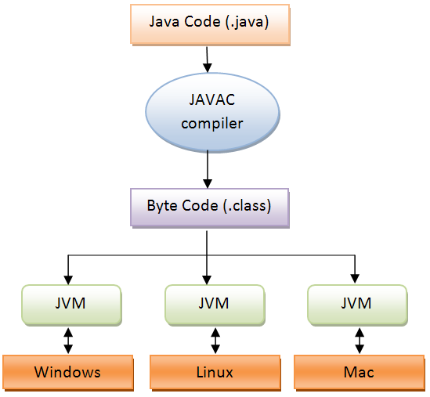
How does Java run? (Platform independency)

Slide 11
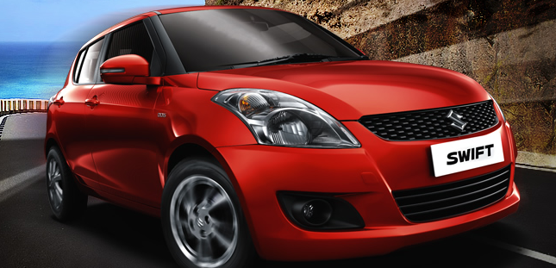
Object orientation
It is about human perception of things.
When we see something we focus on essentials details and not the low level details.
Ex:

Slide 12
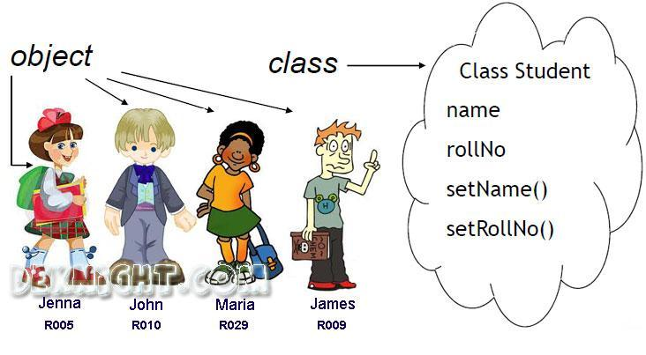
Object oriented concepts
Class and Object (Abstraction and Encapsulation)

Slide 13

Object oriented concepts
Inheritance

Slide 14

Object oriented concepts
Polymorphism

Slide 15
Java Topics
Environment setup – JDK, Eclipse, SVN etc
Java programming basics
Object oriented concepts
Class and Object
Java I/O
Exceptions
Threads
Collections
Annotations, Generics
Reflection API - optional

Slide 16
Tools and Setup
JDK
Eclipse
Eclipse Plugins (SVN)
Google code project

Slide 17
Development Tools
JDK
IDE - Eclipse/Netbeans
SCM Tools -SVN/ GIT
Unit test frameworks – Junit, Test NG etc
Requirement Analysis – Use cases
Design – UML Tools, Visio/Dia etc
Code coverage tools – Eclipse plugins like emma
Bug tracking tools – Bugzilla/JIRA etc
Wiki softwares – Confluence/media wiki etc
Java frameworks – Apache commons, log4j,spring, hibernate, struts etc

Slide 18
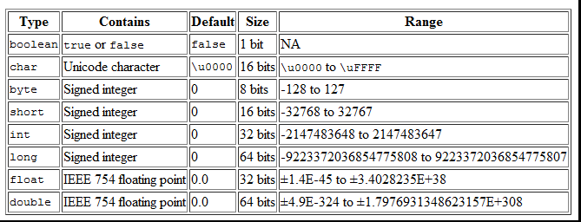
Basic Data Types

Slide 19
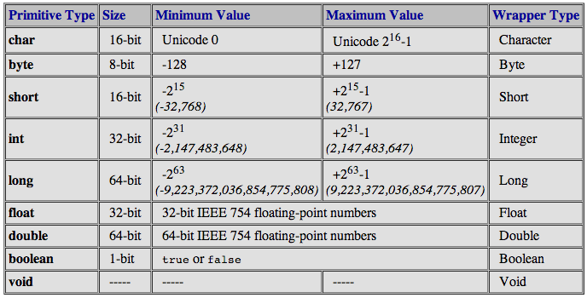

Slide 20
Byte is 8 bit number.
8 bits = 11111111 (2*2*2*2 2*2*2*2)=256
1 bit is for sign, this leave us 7 bits.
7 bits = 2 power 7= 128
0 -1 , 1- 2,…. 127 will be 128th number.
-128 to 1
Range is -128 to 127
Numbers get rotated or cycled if it is not the range. 129 = -127

Slide 21
-60
0 -1 -128
127
60 90

Slide 22
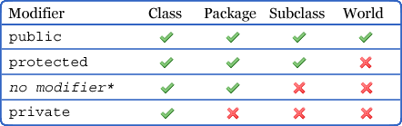
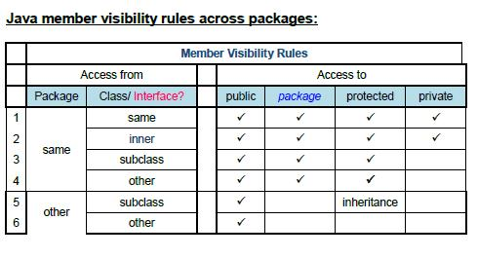
Access Specifiers

Slide 23
Objects in Heap
HelloWorld hello = new HelloWord() //A
hello= new HelloWorld(); //B
B
A
P.C.B
hello

Slide 24
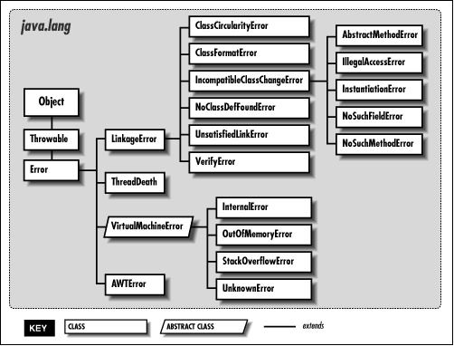
Errors

Slide 25
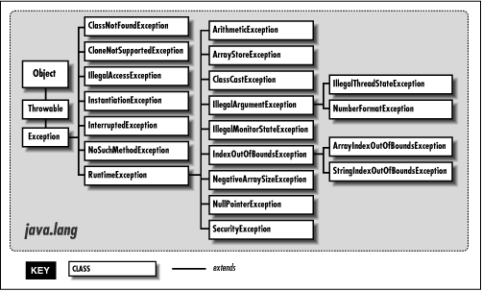
Exceptions

Slide 26
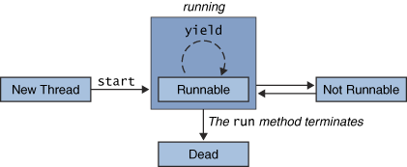
Threads
Threads are light weight processes.
They share resources of the parent.
References: link 1 link 2 memory mgmt dzone

Slide 27
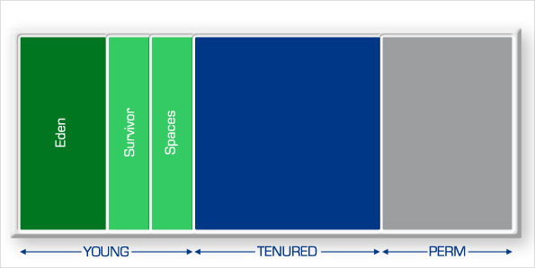
Java memory model

Slide 28
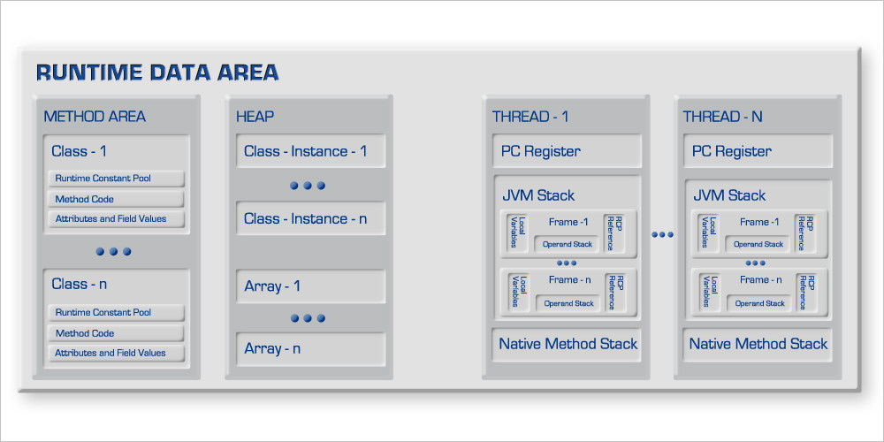
Java threads – Memory model

Slide 29
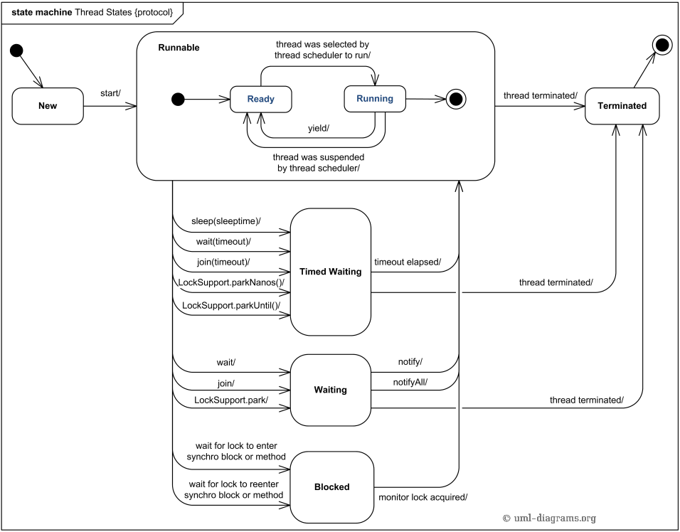

Slide 30
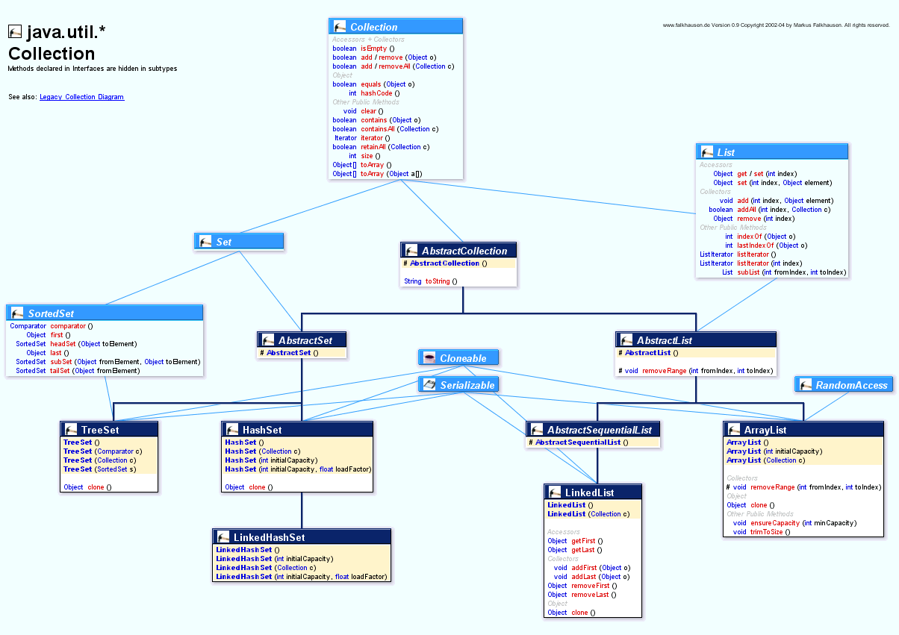
Collections

Slide 31
Projects – Java -FYI
Common Objectives
How to design applications
How to write a proper and better code
Database design
Meet timelines
Unit testing - Optional
Desktop applications
Understand the Java swing framework /JFC
Layouts and other UI elements
Event handling -> wonderful exposure if understood properly
Web applications
Understand the web and http protocol
GET, POST methods, session, application contexts
HTML, Javascript, CSS
Servlets, JSP, Struts framework (optional but industry likes the experience)

Slide 32

Questions?
Let us begin!

